Slide 1
A Simple Abstraction for Complex Concurrent Indexes
OOPSLA 2011
Imperial College London:
Pedro da Rocha Pinto, Thomas Dinsdale-Young, Philippa Gardner and Mark Wheelhouse
University of Cambridge:
Mike Dodds

Slide 2
Motivation
Indexes are ubiquitous in computing systems:
And have a variety of implementations:
Caches
Databases
File systems
JavaScript Objects
Arrays
Linked Lists
Hash Tables
B-trees
Notes:
For the purposes of this talk an index can be thought of as a mapping from keys to values, e.g. a dictionary

Slide 3


Intuitive Index Specification
An index is a partial function mapping keys to values:
There are three basic operations on an index $h$:
r $≔$ search(h,k)
insert(h,k,v)
remove(h,k)
$$H :Keys⇀Vals$$

Slide 4
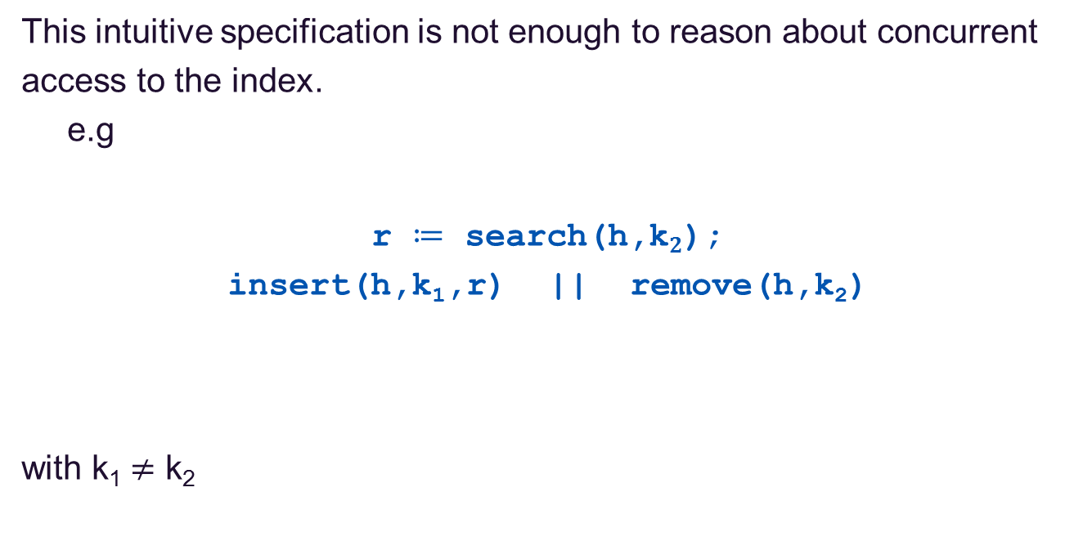
Simple Concurrent Example
This intuitive specification is not enough to reason about concurrent
access to the index.
e.g
r $≔$ search(h,k$2$);
insert(h,k₁,r) || remove(h,k₂)
with k₁ $≠$ k₂
Notes:
Be sure to go over what this program is doing!

Slide 5
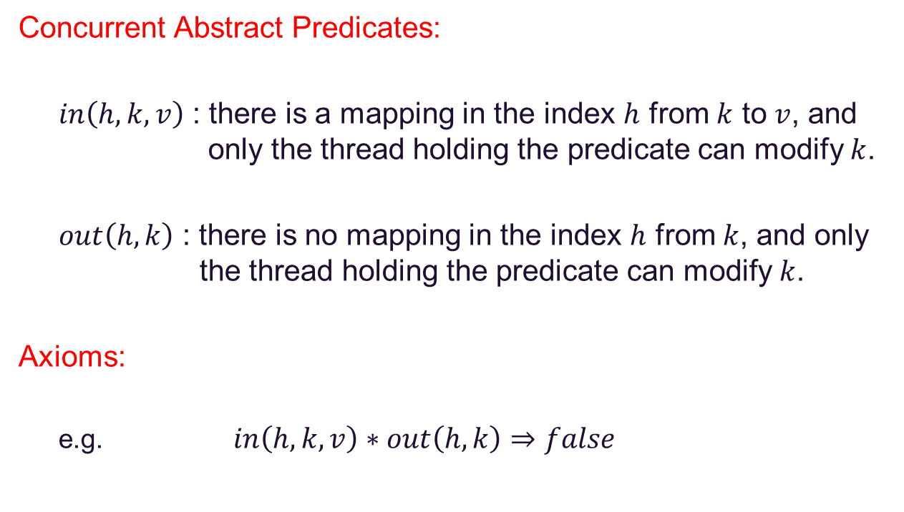
Disjoint Key Concurrency
Concurrent Abstract Predicates:
$in\left(h,k,v\right)$ : there is a mapping in the index $h$ from $k$ to $v$, and only the thread holding the predicate can modify $k$.
$out\left(h,k\right)$ : there is no mapping in the index $h$ from $k$, and only the thread holding the predicate can modify $k$.
Axioms:
e.g. $in\left(h,k,v\right)∗out\left(h,k\right)⇒false$
Notes:
Represent the state of the index with predicates which describe partial knowledge of the state. Mention SL, or at least disjointness.

Slide 6
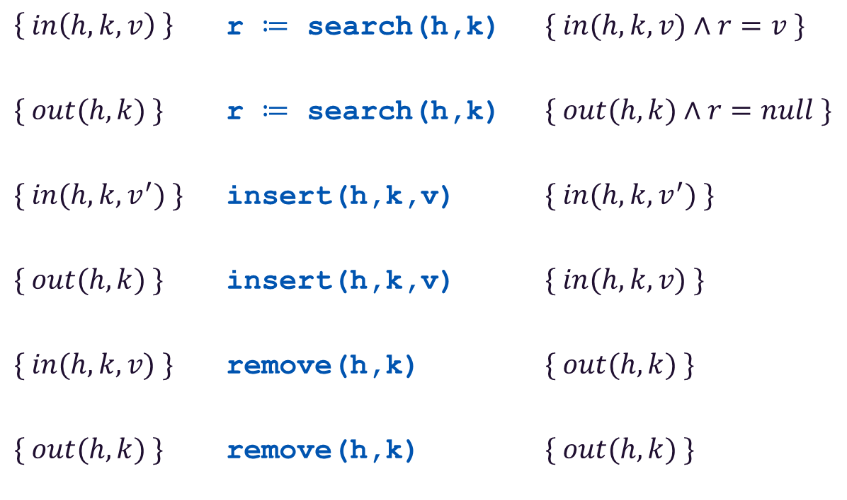
Concurrent Index Specification
$\left\{ in\left(h,k,v\right) \right\}$ r $≔$ search(h,k) $\{ in(h,k,v)∧r=v \}$
$\{ out(h,k) \}$ r $≔$ search(h,k) $\{ out(h,k)∧r=null \}$
$\{ in(h,k,v^{′}) \}$ insert(h,k,v) $\{ in(h,k,v^{′}) \}$
$\{ out(h,k) \}$ insert(h,k,v) $\{ in(h,k,v) \}$
$\{ in(h,k,v) \}$ remove(h,k) $\{ out(h,k) \}$
$\{ out(h,k) \}$ remove(h,k) $\{ out(h,k) \}$

Slide 7
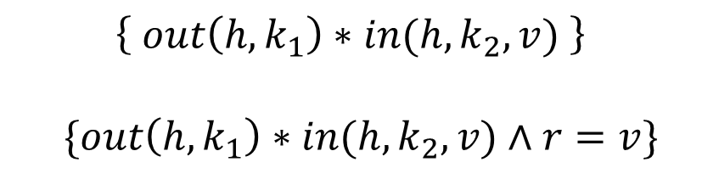



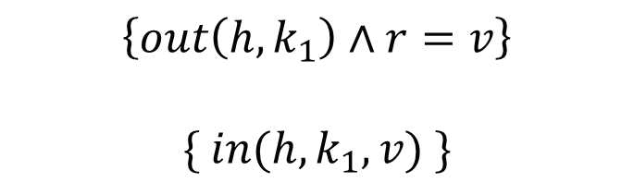
Simple Concurrent Example
r $≔$ search(h,k$2$);
insert(h,k₁,r) remove(h,k₂)
$$\left\{ out\left(h,k_{1}\right)∗in(h,k_{2},v) \right\}$$
$$\{out\left(h,k_{1}\right)∗in(h,k_{2},v)∧r=v\}$$
$$\left\{out\left(h,k_{1}\right)∧r=v\right\}$$
$$\{ in(h,k_{1},v) \}$$
$$\left\{in(h,k_{2},v)\right\}$$
$$\{ out(h,k_{2}) \}$$
$$\left\{ in\left(h,k_{1},v\right)∗out\left(h,k_{2}\right) \right\}$$

Slide 8
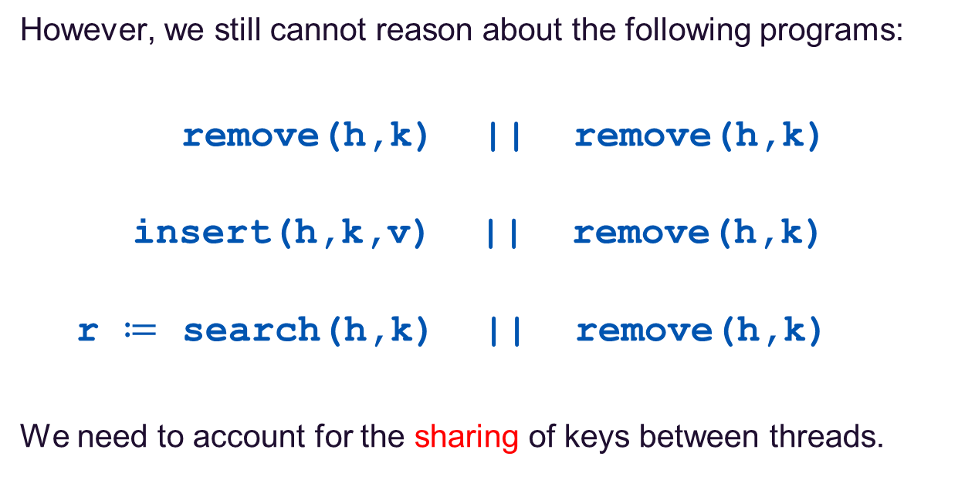
More Example Programs
However, we still cannot reason about the following programs:
remove(h,k) || remove(h,k)
insert(h,k,v) || remove(h,k)
r $≔$ search(h,k) || remove(h,k)
We need to account for the sharing of keys between threads.

Slide 9
Real-World Client Programs
Database sanitation:
remove all patients who have been cured, transferred or released
Graphics drawing:
clip all objects outside of some horizontal and vertical bounds
Garbage collection:
parallel marking in the mark/sweep algorithm
Web caching (NOSQL):
removing a picture whilst others are attaching comments to it

Slide 10
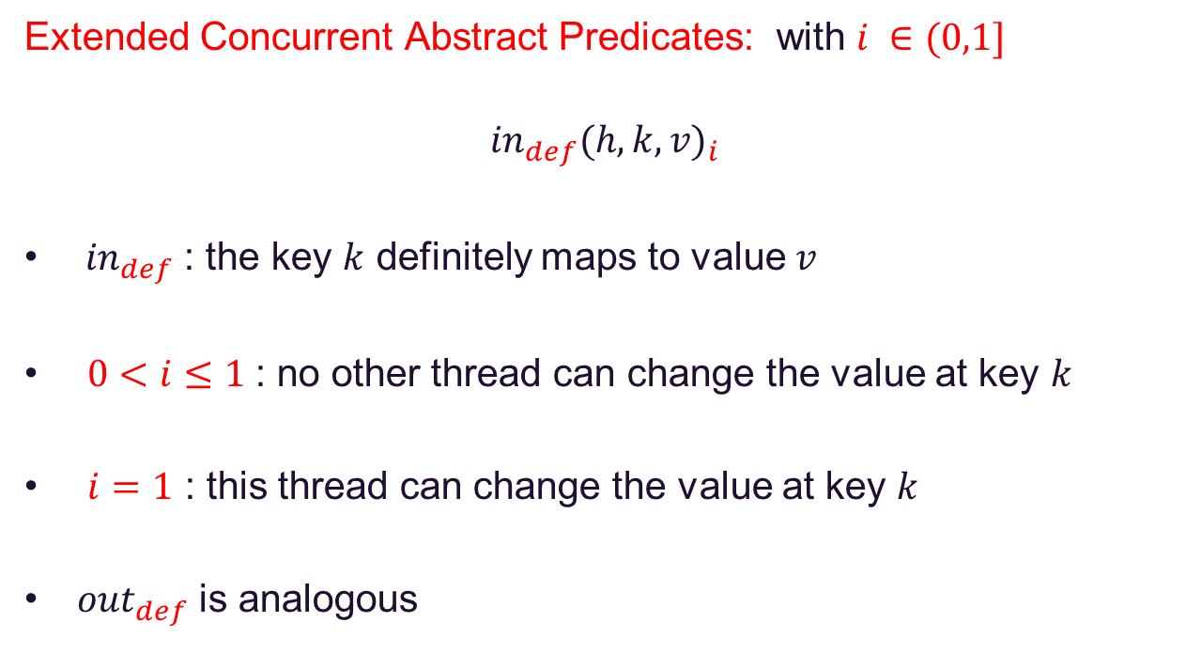
Shared Key Concurrency
Extended Concurrent Abstract Predicates: with $i ∈(0,1]$
$${{in}_{def}(h,k,v)}_{i}$$
${in}_{def}$ : the key $k$ definitely maps to value $v$
$0<i≤1$: no other thread can change the value at key $k$
$i=1$ : this thread can change the value at key $k$
${out}_{def}$ is analogous

Slide 11
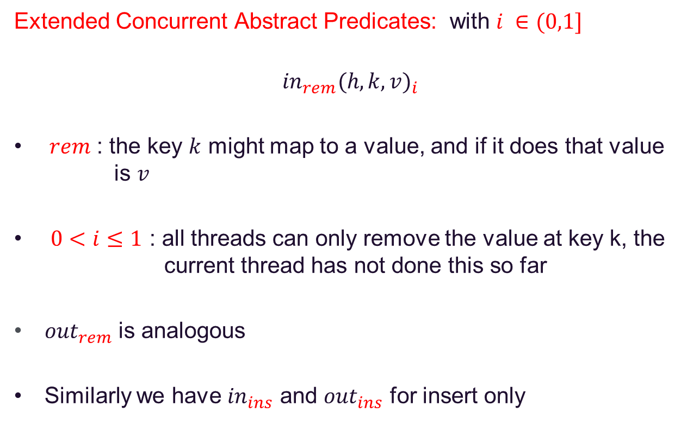
Shared Key Concurrency
Extended Concurrent Abstract Predicates: with $i ∈(0,1]$
$${{in}_{rem}(h,k,v)}_{i}$$
$rem$ : the key $k$ might map to a value, and if it does that value is $v$
$0<i≤1$ : all threads can only remove the value at key k, the current thread has not done this so far
${out}_{rem}$ is analogous
Similarly we have ${in}_{ins}$ and ${out}_{ins}$ for insert only

Slide 12
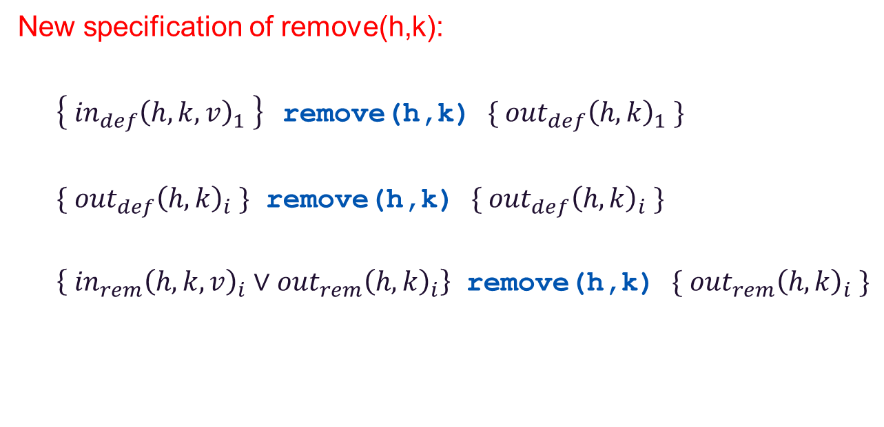
Concurrent Index Specification
New specification of remove(h,k):
$\left\{{ {in}_{def}\left(h,k,v\right)}_{1} \right\}$remove(h,k) $\{ {{out}_{def}\left(h,k\right)}_{1} \}$
$\{{{ out}_{def}\left(h,k\right)}_{i} \}$ remove(h,k) $\{{{ out}_{def}\left(h,k\right)}_{i} \}$
$\left\{{ {in}_{rem}\left(h,k,v\right)}_{i}{ ∨{out}_{rem}\left(h,k\right)}_{i}\right\}$ remove(h,k) $\{{ {out}_{rem}\left(h,k\right)}_{i} \}$

Slide 13
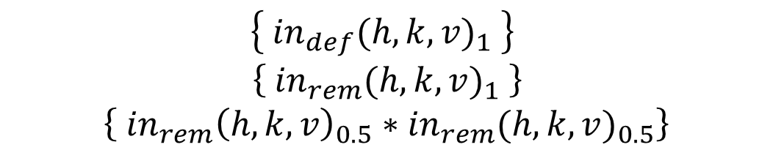



Concurrent remove
$$\left\{ {in}_{def}{(h,k,v)}_{1} \right\}$$
$\left\{ {in}_{rem}{(h,k,v)}_{1} \right\}$
$$\left\{ {in}_{rem}{\left(h,k,v\right)}_{0.5}∗{in}_{rem}{(h,k,v)}_{0.5}\right\}$$
$$\left\{{ in}_{rem}{\left(h,k,v\right)}_{0.5}\right\}$$
$$\left\{{ out}_{rem}{\left(h,k\right)}_{0.5} \right\}$$
$$\left\{ {in}_{rem}{\left(h,k,v\right)}_{0.5} \right\}$$
$$\left\{{ out}_{rem}{\left(h,k\right)}_{0.5}\right\}$$
remove(h,k) remove(h,k)
$$\left\{{ out}_{rem}{\left(h,k\right)}_{0.5}∗{ out}_{rem}{\left(h,k\right)}_{0.5}\right\}$$
$$\left\{ {out}_{def}{(h,k)}_{1} \right\}$$
Notes:
Describe axioms as they are used…

Slide 14
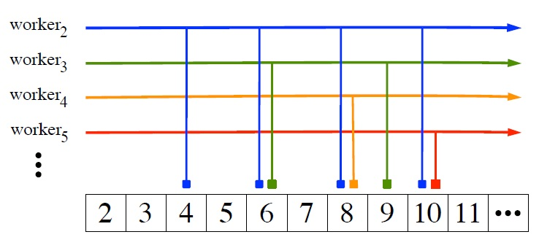
Parallel Sieve of Eratosthenes
Notes:
Representative example, don’t overdo this slide! (don’t say clobber)

Slide 15
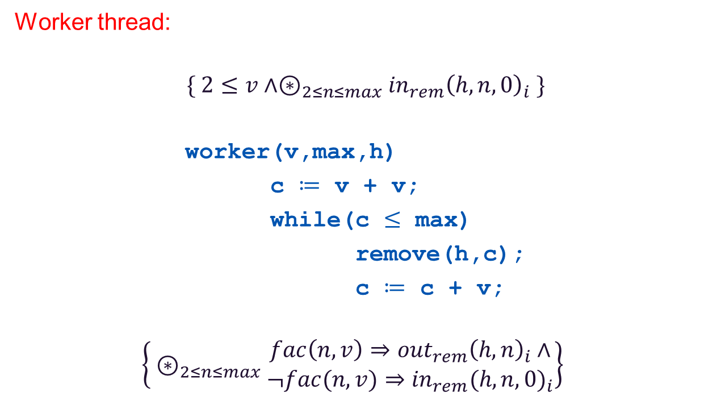
Parallel Sieve of Eratosthenes
Worker thread:
$$\{ 2≤v∧⊛_{2≤n≤max}{in}_{rem}{\left(h,n,0\right)}_{i} \}$$
worker(v,max,h)
c $≔$ v + v;
while(c $≤$ max)
remove(h,c);
c $≔$ c + v;
$$\left\{{ ⊛}_{2≤n≤max} \begin{matrix}fac\left(n,v\right)⇒{out}_{rem}{\left(h,n\right)}_{i}∧ \\ ¬fac(n,v)⇒{in}_{rem}{(h,n,0)}_{i}\end{matrix}\right\}$$
Notes:
Each worker removes all of the multiples of v from the index.

Slide 16
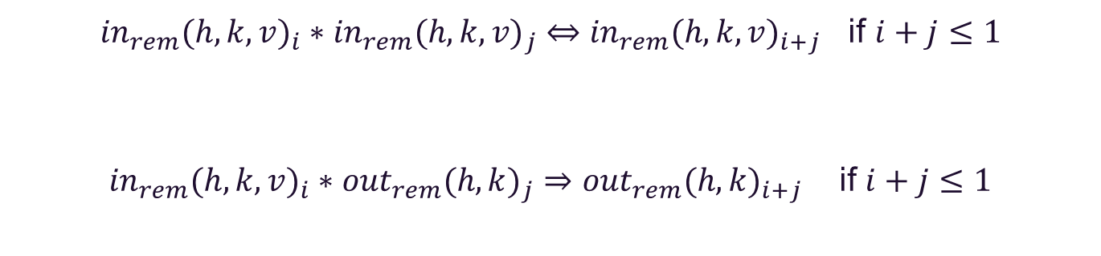
Combining Predicates
${{in}_{rem}(h,k,v)}_{i}{∗{in}_{rem}(h,k,v)}_{j} ⇔{{in}_{rem}(h,k,v)}_{i+j}$ if $i+j≤1$
${{in}_{rem}(h,k,v)}_{i}∗{{out}_{rem}(h,k)}_{j}⇒{{out}_{rem}(h,k)}_{i+j}$ if $i+j≤1$

Slide 17
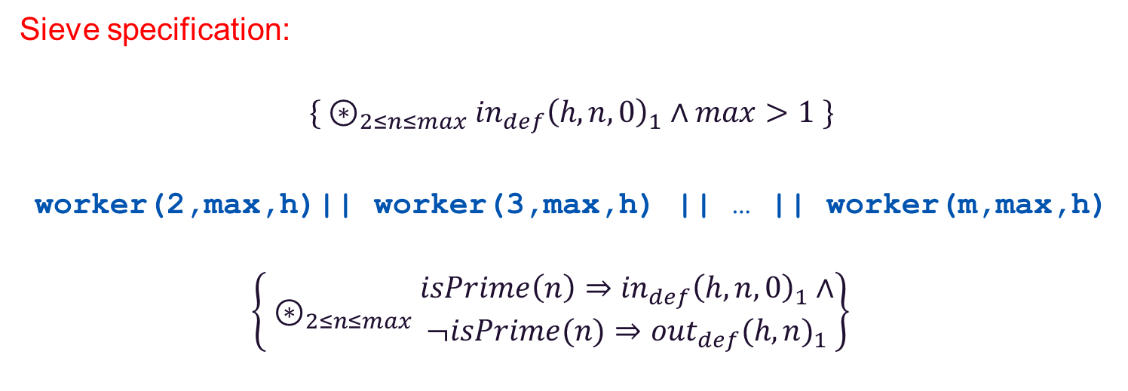

Parallel Sieve of Eratosthenes
Sieve specification:
$$\{{ ⊛}_{2≤n≤max} {in}_{def}{\left(h,n,0\right)}_{1}∧max>1 \}$$
worker(2,max,h)|| worker(3,max,h) || … || worker(m,max,h)
$$\left\{{ ⊛}_{2≤n≤max} \begin{matrix}isPrime\left(n\right)⇒{in}_{def}{\left(h,n,0\right)}_{1}∧ \\ ¬isPrime(n)⇒{out}_{def}{(h,n)}_{1}\end{matrix}\right\}$$
where m = $\left\lfloor \sqrt{max}\right\rfloor$
Notes:
Each worker gets some rem permission of the whole index.

Slide 18
Implementing a Concurrent Index
Our abstract concurrent index specification is sound for a number
of different implementations, including:
Arrays
Linked Lists
Hash Tables
B-trees

Slide 19
Concurrent B-tree
Notes:
Don’t say hard! Talk about search structure. Search lock free, others low lock, defect in Sagiv’s paper.

Slide 20
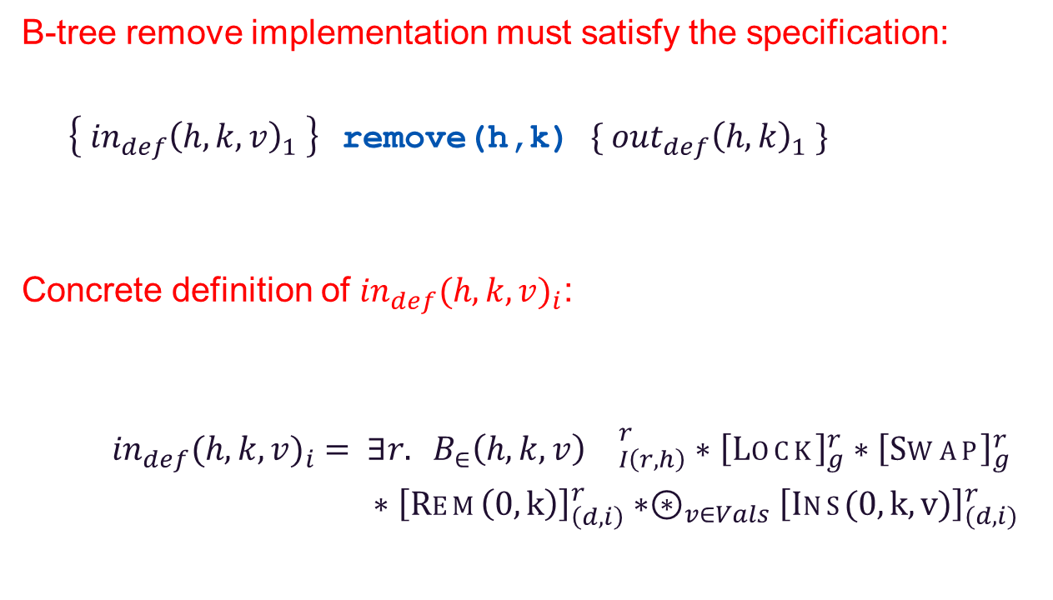
Concurrent B-tree
B-tree remove implementation must satisfy the specification:
$\left\{{ {in}_{def}\left(h,k,v\right)}_{1} \right\}$remove(h,k) $\{ {{out}_{def}\left(h,k\right)}_{1} \}$
Concrete definition of ${in}_{def}{(h,k,v)}_{i}$:
${in}_{def}{(h,k,v)}_{i} = ∃r. B_{∈}\left(h,k,v\right){}_{I\left(r,h\right)}^{r}∗{\left[Lock\right]}_{g}^{r}∗{\left[Swap\right]}_{g}^{r}$
$∗{\left[Rem\left(0,k\right)\right]}_{\left(d,i\right)}^{r}∗⊛_{v∈Vals}{\left[Ins(0,k,v)\right]}_{(d,i)}^{r}$
Interference
environment
Shared state
Capability tokens
Notes:
We need to give concrete def: 3 bits, shared region, interference environment, capability tokens.

Slide 21
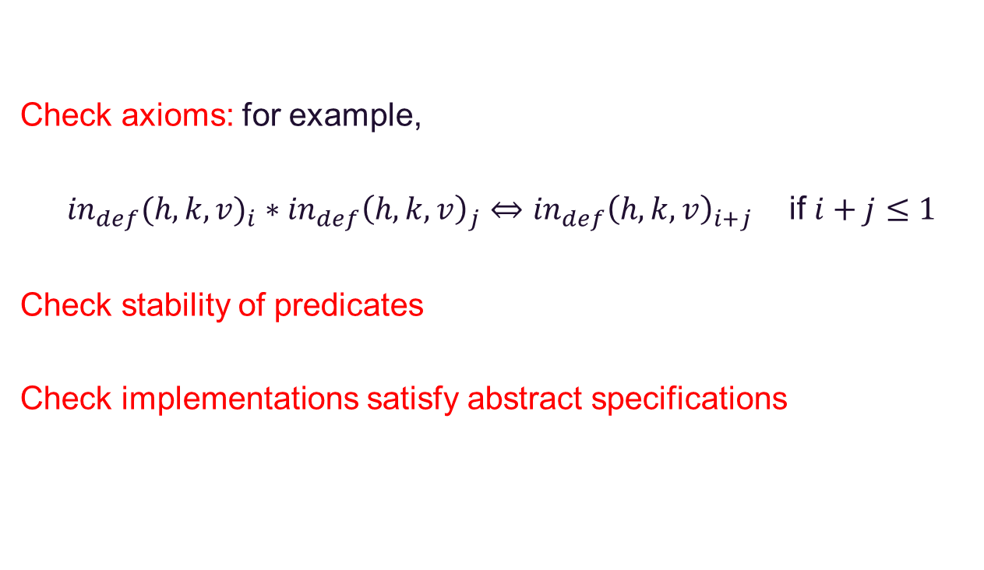
Concurrent B-tree
Check axioms: for example,
${in}_{def}{(h,k,v)}_{i} ∗{in}_{def}{\left(h,k,v\right)}_{j}⇔{in}_{def}{\left(h,k,v\right)}_{i+j}$ if $i+j≤1$
Check stability of predicates
Check implementations satisfy abstract specifications

Slide 22
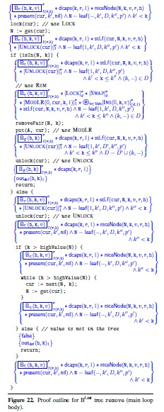
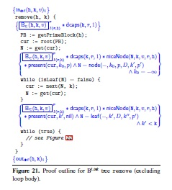
Concurrent B-tree
Proof of remove
implementation:
Notes:
Not too long a proof. Other cases very similar, suggests automation possible.

Slide 23
Conclusion
Summary:
simple abstract spec for concurrent indexes
essence of real-world client programs
correct implementations
linked lists
hash tables
concurrent B-trees
proof structure lends itself to automation
Future work:
Automation/Proof Assistant (Dinsdale-Young)
java.util.concurrent (da Rocha Pinto)
File Systems (Ntzik)

